Slide 1
Electromagnetic Radiation
Most remotely sensed data is derived from Electromagnetic Radiation (EMR). This includes:
  Visible light
  Infrared light (heat)
  X-Rays
  Radar
  Etc.
To use RS data we need to review some information on EM

Slide 2
Electromagnetic Radiation

Slide 3
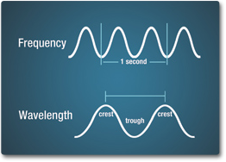
Electromagnetic Energy
Wave Theory - c = 𝜆 x 𝜐
Speed of Light (c) = wavelength x frequency (𝜆 x 𝜐)
c = 3 x 10⁸ m/sec (the speed of light) = 186,000 miles/sec
Wavelength (𝜆) – the distance from one wave peak (or crest) to the next is the wavelength
Frequency (𝜐) - the number of peaks passing a fixed point in a space per a given time unit

Slide 4
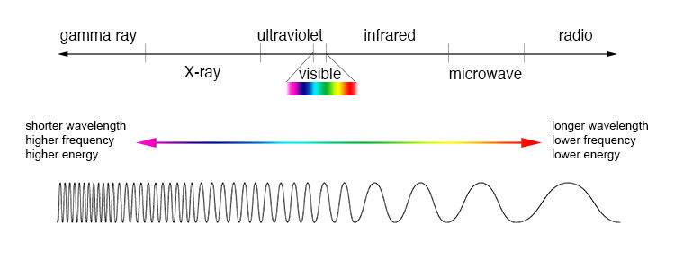
Electromagnetic Spectrum
Name | Wavelength (meters)
Gamma-rays | < 10⁻¹¹
X-rays | 10⁻¹¹ - 10⁻⁸
Ultraviolet (UV) | 10⁻⁸ - 4 x 10⁻⁷
Visible (Optical) | 4 x 10⁻⁷ - 7 x 10⁻⁷
Infrared (IR) | 7 x 10⁻⁷ - 10⁻³
Microwave | 10⁻³ - 10⁻²
Radio | 10⁻² - 10⁴

Slide 5
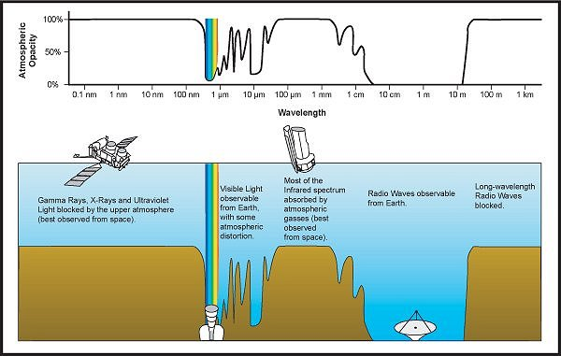
Atmospheric Absorption

Slide 6
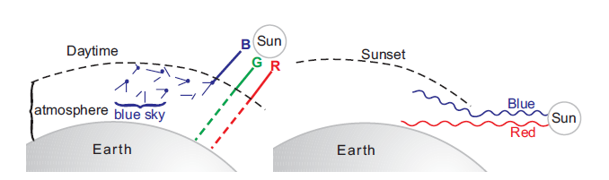
Scattering
In the absence of particles and scattering the sky would appear black.
At sunrise and sunset the sunlight travels a longer distance through the atmosphere
With the longer path the scatter and absorption is of the short (blue) wavelengths is so complete we only see the longer wavelengths of light, the red and orange
Source: Principles of Remote Sensing (Tempfli et al.)

Slide 7
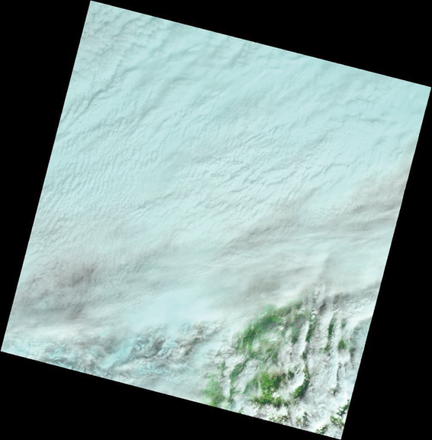
Impact of Atmospheric Interaction
Clouds!
Landsat 8 imagery of the North Coast

Slide 8
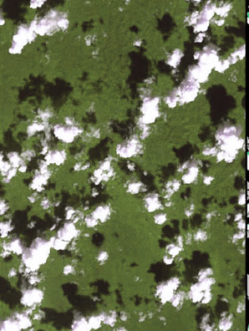
Impact of Atmospheric Interaction
Cloud Shadows

Slide 9
Energy Interaction with the Earth’s Surface
The proportion of energy reflected, absorbed and transmitted will vary depending on the surface material and condition
The proportion of energy reflected, absorbed and transmitted will also vary at different wavelength
Absorption (A) occurs when radiation (energy) is absorbed into the target
Transmission (T) occurs when radiation passes through a target.
Reflection (R) occurs when radiation "bounces" off the target and is redirected

Slide 10
Energy Interaction with the Earth’s Surface
The proportion of energy reflected, absorbed and transmitted will vary depending on the surface material and condition
For example:
Vegetation and soils can reflect approximately 30-50% of the incident energy (across the entire EM spectrum)
Water on the other hand reflects only 10% of incident energy. It reflects most of this in the visible range, minimal in the NIR and beyond 1.2 μm (mid-infrared) all energy is absorbed.

Slide 11
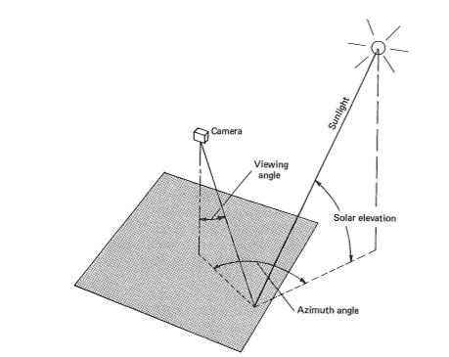
Reflectance
Necessary to consider viewing geometry and illumination geometry
Basically the azimuth angle, viewing angle, and solar elevation

Slide 12
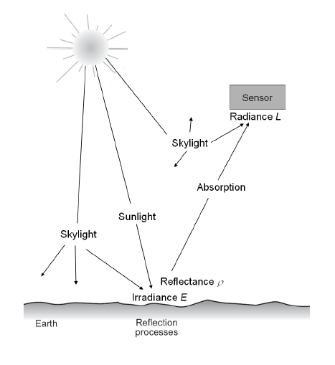

Radiance vs. Reflectance
The atmosphere affects radiance in two ways:
Reduces (or attenuates) the energy
Atmosphere itself is a reflector, adding scatter, “path radiance” to the signal detected by the sensor.

Slide 13
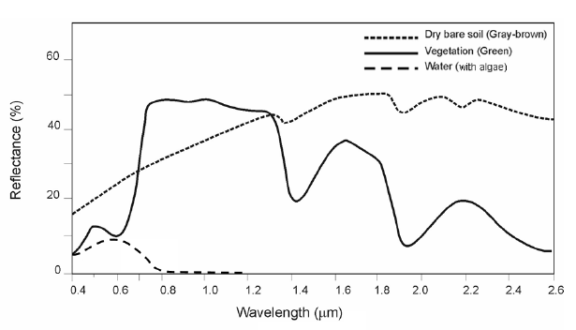
Spectral Reflectance Curves
Spectral Reflectance Curves for three materials shown in the visible and infrared wavelengths

Slide 14
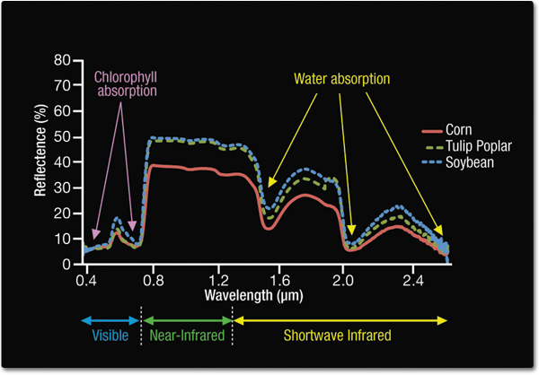
Spectral Reflectance Curve - Vegetation
Infrared reflection

Slide 15
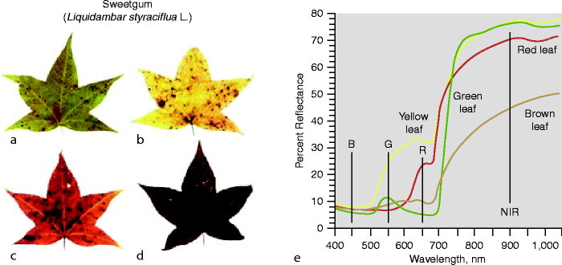
Spectral Reflectance Curve - Vegetation
As a plant stops or reduces chlorophyll production, it absorbs less in the red bands (therefore reflects more red) producing yellow color of dying vegetation.
Red color of some leaves produced by carotenoids which are always present but usually masked by chlorophyll

Slide 16
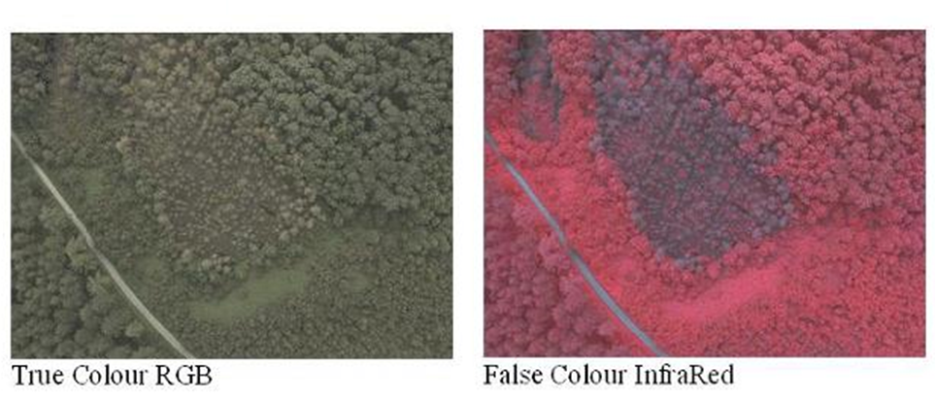
Spectral Reflectance - Vegetation
Remote sensed imagery can be used to detect stressed or diseased plants
High NIR reflectance / Low visible reflectance = Healthy
Low NIR reflectance / High visible reflectance = Unhealthy

Slide 17
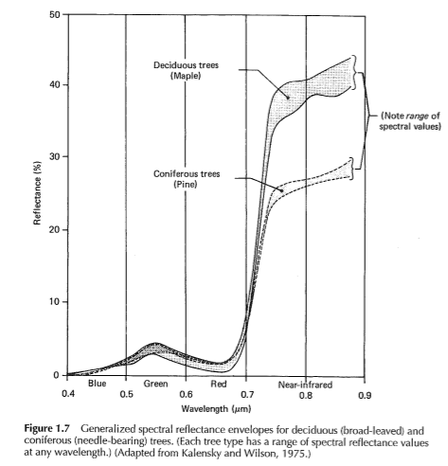
Spectral Reflectance Curve - Vegetation

Slide 18
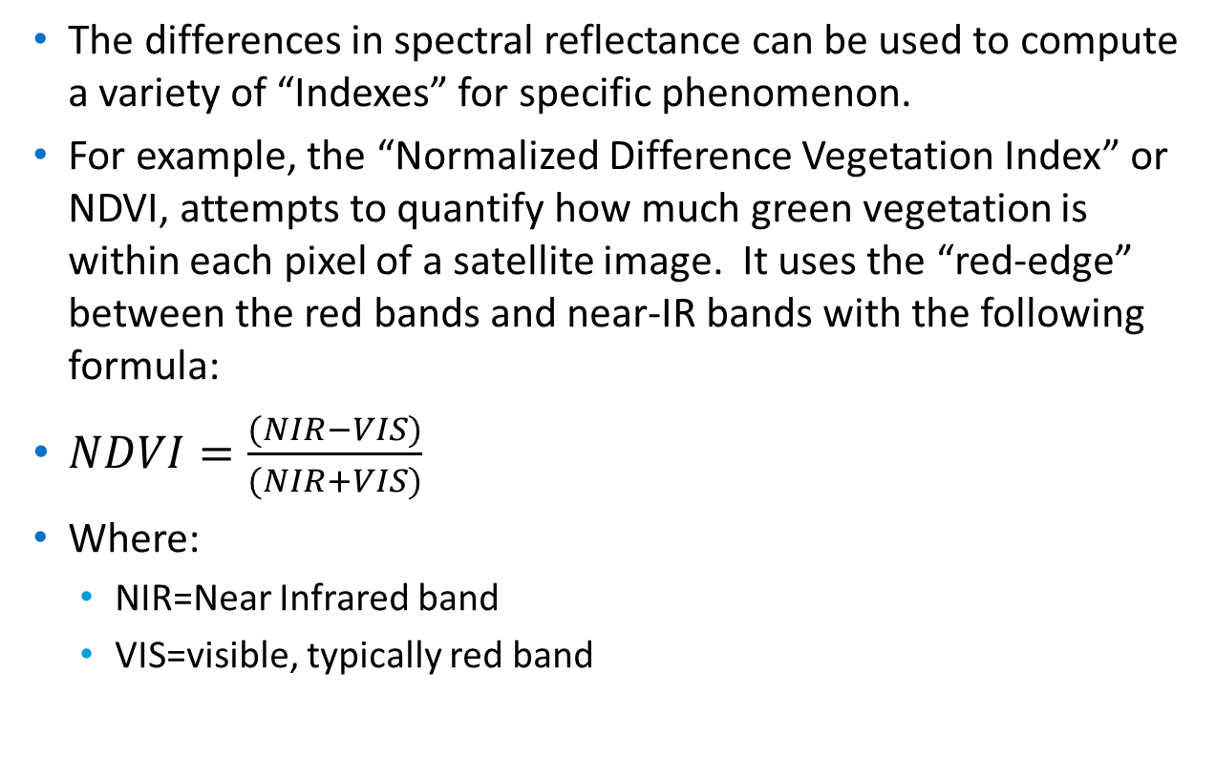
NDVI
The differences in spectral reflectance can be used to compute a variety of “Indexes” for specific phenomenon.
For example, the “Normalized Difference Vegetation Index” or NDVI, attempts to quantify how much green vegetation is within each pixel of a satellite image. It uses the “red-edge” between the red bands and near-IR bands with the following formula:
$NDVI=\frac{(NIR−VIS)}{(NIR+VIS)}$
Where:
  NIR=Near Infrared band
  VIS=visible, typically red band

Slide 19
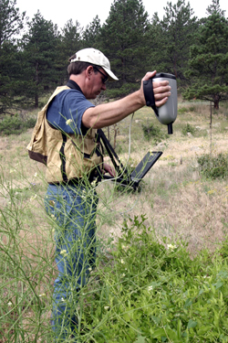
Ground Truthing
How do you know if something derived from satellite data is correct?
Ground-truthing is when you validate your remotely sensed data with data from the “ground”.
Ground-truthing varies with the type of data and your goals.
Examples:
  Measuring vegetation reflectance and comparing it with satellite data
  Performing object recognition and comparing with the actual objects on the ground
www.asdi.com

